Slide 1
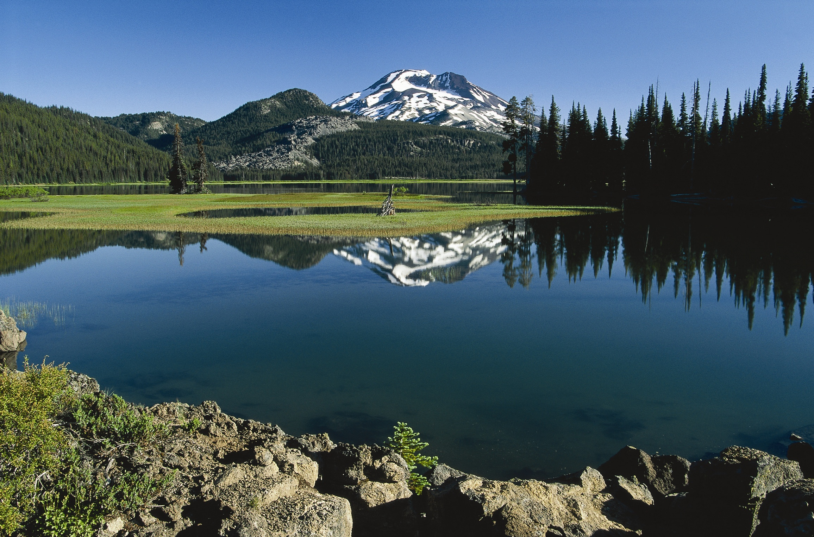
THE FEDERAL TRUST RESPONSIBILITY IN ENVIRONMENTAL LAW
Native Environmental Sovereignty Project
University of Oregon School of Law
Mary Christina Wood
Philip H. Knight Professor of Law
Seth Bichler, JD expected 2014
Amanda Rogerson, Fellow, JD expected 2014
Available at: http://law.uoregon.edu/faculty/mwood/tribalenv/
Notes:
1

Slide 2


Notes:
THE POINT OF THIS SLIDE IS THAT AGENCY OFFICIALS COME INTO A STATUTORY CONTEXT THAT’S BEEN CREATED IN THE LAST FOUR DECADES AND MAY NOT BE AWARD OF THE EARLY SOVEREIGN OBLIGATIONS OF PROPERTY LAW THAT PERSIST TODAY.

Slide 3
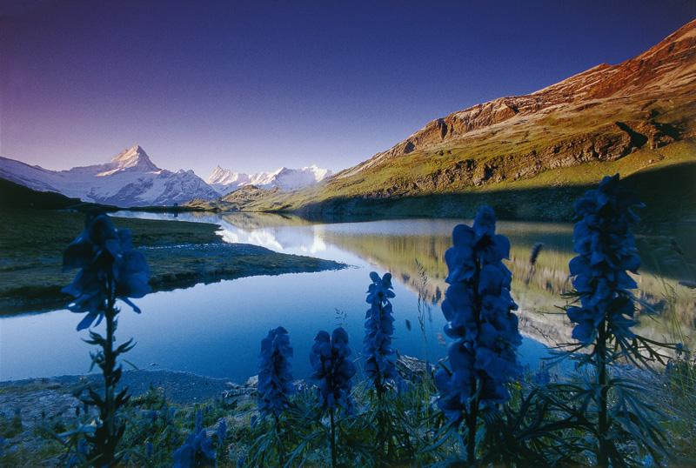
THE SOVERIGN TRUST FRAMEWORK
Notes:
3

Slide 4
THE SOVERIGN TRUST FRAMEWORK
MODERN ENVIRONMENTAL LAW
Notes:
4

Slide 5
THE SOVERIGN TRUST FRAMEWORK
MODERN ENVIRONMENTAL LAW
CARRYING OUT THE INDIAN TRUST OBLIGATION IN ENVIRONMENTAL LAW
Notes:
5

Slide 6
THE SOVEREIGN TRUST FRAMEWORK
Notes:
6

Slide 7
THE SOVEREIGN TRUST FRAMEWORK– A PROPERTY FRAMEWORK
Notes:
7

Slide 8
THE SOVEREIGN TRUST FRAMEWORK – A PROPERTY FRAMEWORK
  THE INDIAN TRUST OBLIGATION AND TREATY RIGHTS
Notes:
8

Slide 9
THE SOVEREIGN TRUST FRAMEWORK– A PROPERTY FRAMEWORK
  THE INDIAN TRUST OBLIGATION AND TREATY RIGHTS
  THE PUBLIC TRUST
Notes:
9

Slide 10
INDIAN TRUST AND TREATY RIGHTS
Notes:
10

Slide 11
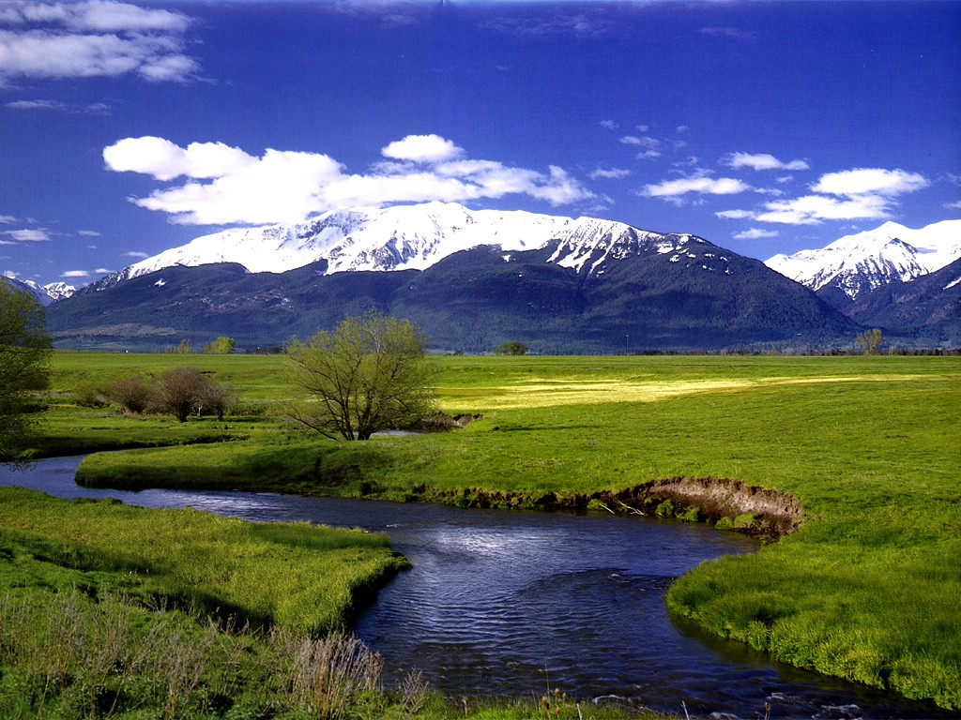
The Federal Indian Trust Obligation
Widely described by courts as a “cornerstone” of federal Indian law.

Slide 12
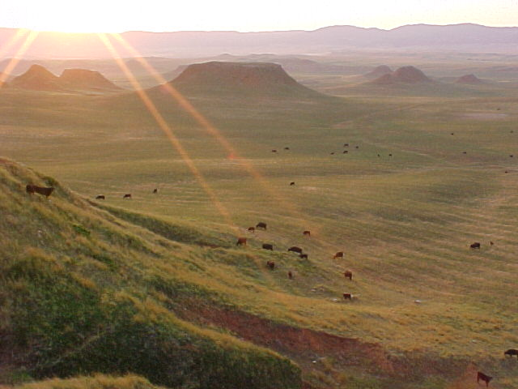
Expression in the Courts
  The ownership of Indian trust lands analogous to "one existing under a common law trust, with the United States as trustee, the Indian tribes or individuals as beneficiaries, and the property and natural resources managed by the United States as the trust corpus."
  Dept. of Interior v. Klamath Water Users Protective Ass’n, 532 U.S. 1 (2001).

Slide 13
[T]he trust responsibility is best understood as a duty arising from the transfer of native lands to the federal government. . . . [It] represents that measure of legal responsibility on the part of the majority society to protect what the native population retained (Wood 1995).

Slide 14
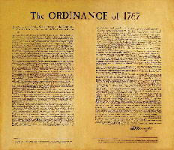
THE NORTHWEST ORDINANCE, FOR EXAMPLE, REFLECTED THIS:
“The utmost good faith shall always be observed towards the Indians. . . and, in their property, rights, and liberty, they shall never be invaded or disturbed . . . ”
Notes:
Needs picture of northwest ordinance or some background

Slide 15
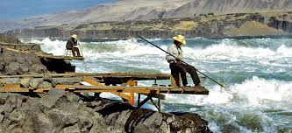
TREATY RIGHTS – SOVERIGN DEEDS OF LAND AND RESERVATIONS OF PROPERTY RIGHTS
“the treaty was not a grant of rights to the Indians but a grant of right from them, -a reservation of those not granted.” U.S. v Winans 198 U.S. 371, 381 (1905)

Slide 16
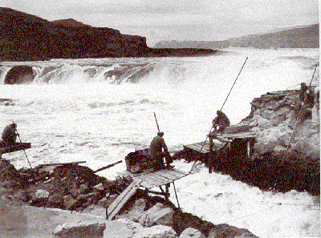
Stevens Treaty Language
“The right of taking fish at all usual and accustomed fishing stations . . . is secured to said Indians”
Notes:
Perhaps we need to slightly fade the picture behind?

Slide 17
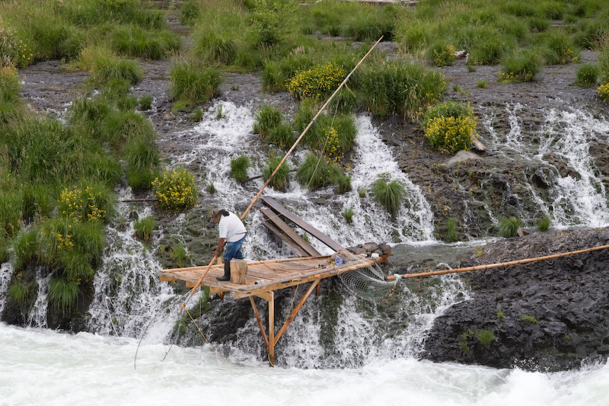
"My ancestor who signed the treaty accepted the word of the United States that this treaty would protect not only the Indian way of life for those then living, but also for all generations yet unborn."
- Jerry Meninick, Yakama Nation

Slide 18
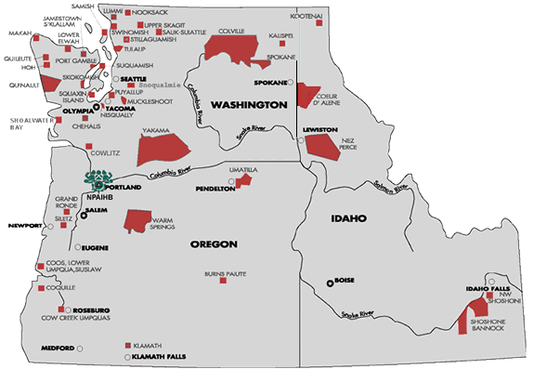
Property rights essential to protecting “Islands of Indianness”
-- Charles Wilkinson

Slide 19
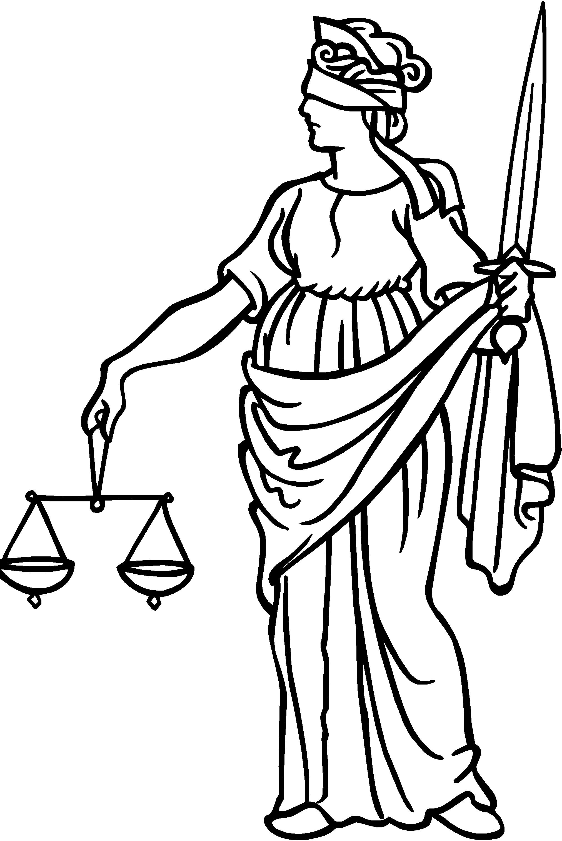
  "The mere passage of time has not eroded, and cannot erode the rights guaranteed by solemn treaties that both sides pledged on their honor to uphold."
  Chippewa v. Michigan, 471 F.Supp. 192, 280 (D.C. Mich., 1979).
Notes:
Need better color for this - background

Slide 20
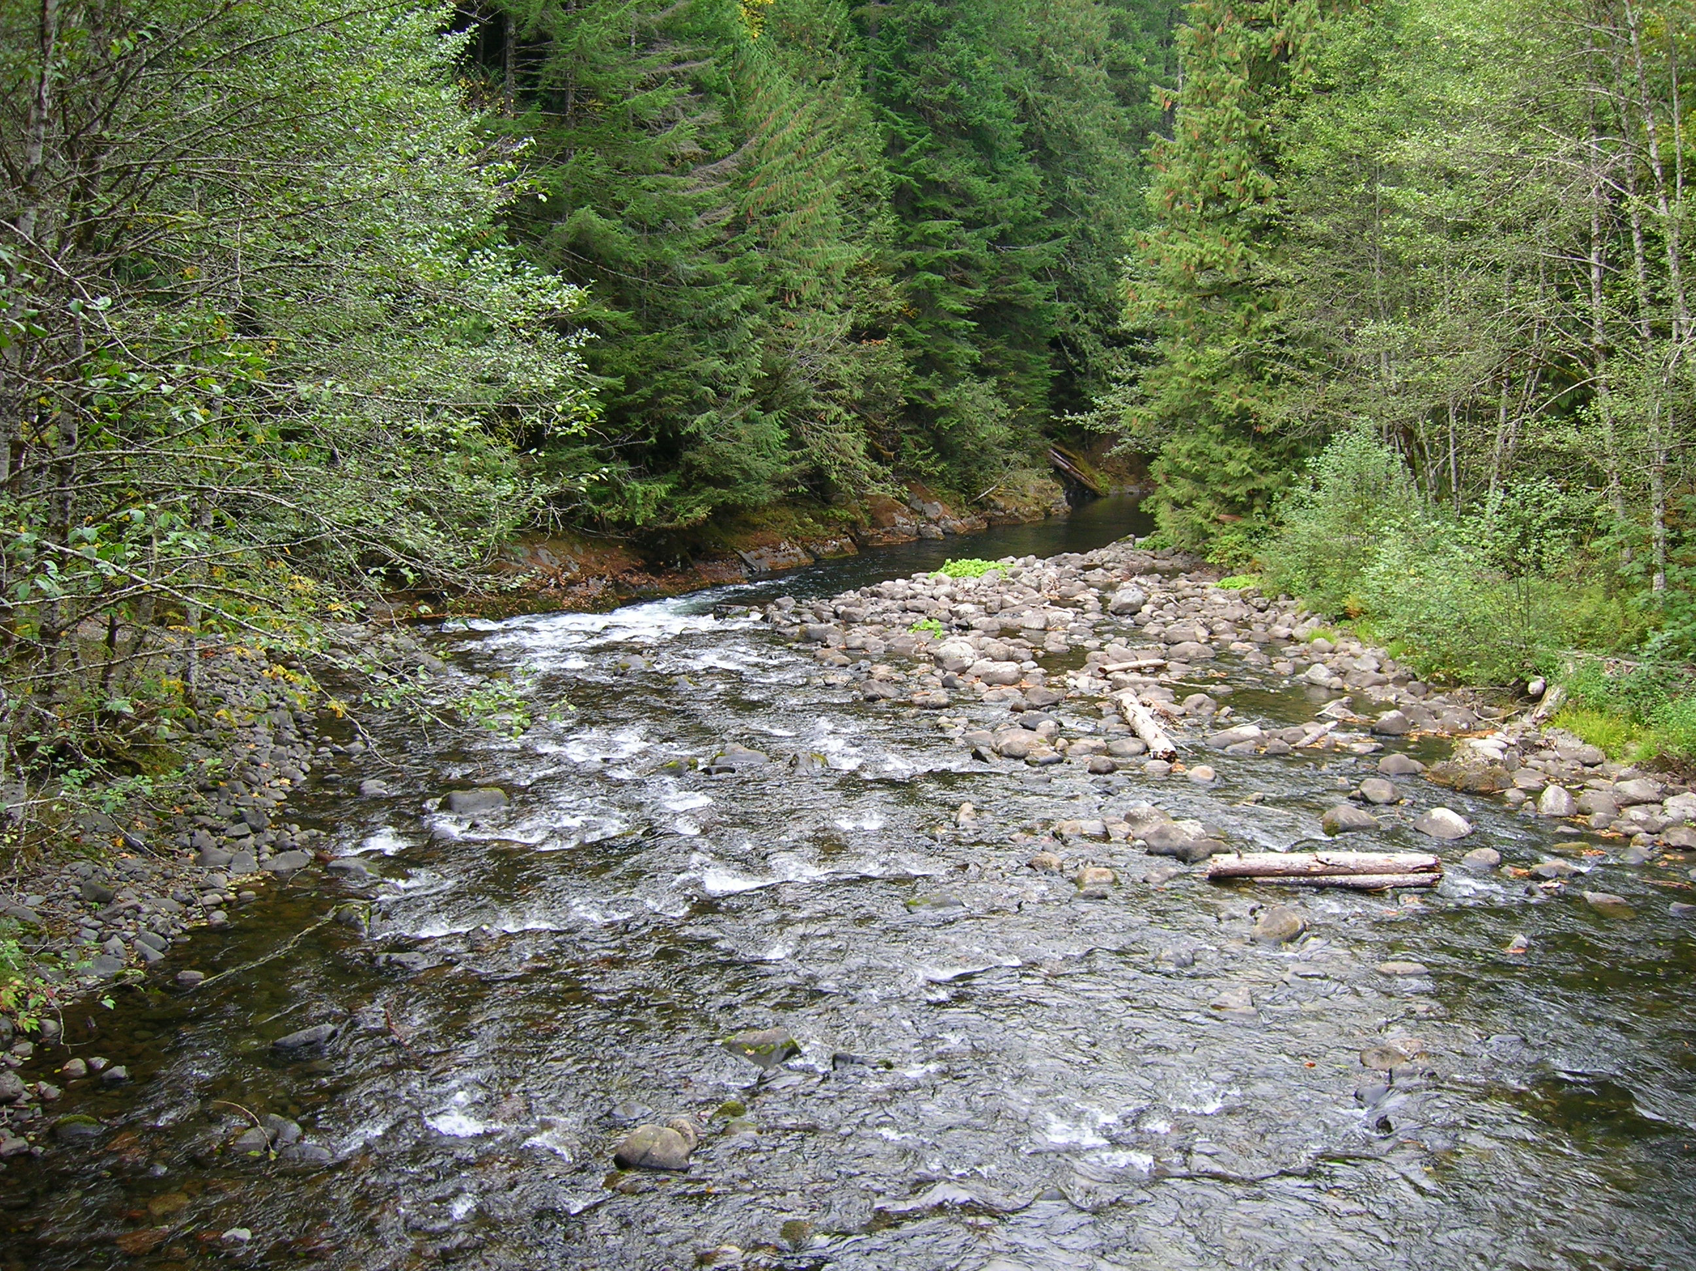
  Declared sovereign property rights
The Treaty Rights

Slide 21
  Declared sovereign property rights
  Easements on ceded land (Stevens treaties)
The Treaty Rights

Slide 22
  Declared sovereign property rights
  Easements on ceded land (Stevens treaties)
  Implied water rights
The Treaty Rights

Slide 23
  Declared sovereign property rights
  Easements on ceded land (Stevens treaties)
  Implied water rights
  Implied right of environmental protection (Stevens treaties)
The Treaty Rights

Slide 24
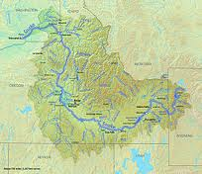
Property rights and duties extend off the reservation
The treaty established “something analogous to a co-tenancy, with the tribes as one co-tenant and all citizens of the Territory (and later of the state) as the other.”
Puget Sound Gillnetters Ass’n, 573 F. 2d 1123, 1126 (9th Cir. 1978)

Slide 25
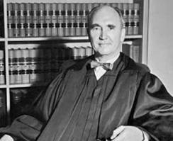


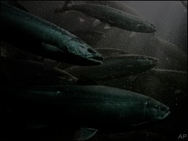
Co-tenancy for shared assets:
Pacific treaty fishing cases
“Co-tenants stand in a fiduciary relationship one to the other. . . . A court will enjoin the commission of waste. By analogy, neither the treaty Indians nor the State on behalf of its citizens may permit the subject matter of these treaties to be destroyed. “
United States v. Washington, 520 F.2d 676, 685 (9th Cir. 1975).
Notes:
Fade picture behind a bit to show wording

Slide 26
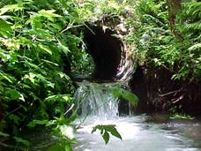
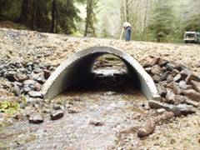
Culverts Litigation

Slide 27
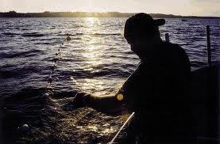
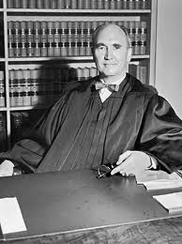
Institutional remedies using power of equity

Slide 28
THE PUBLIC TRUST
ANOTHER SOVEREIGN PROPERTY OBLIGATION
Notes:
28

Slide 29
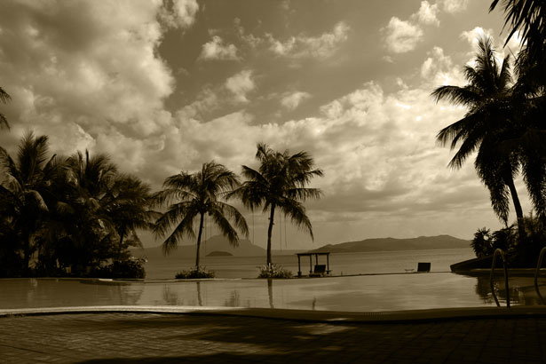
The Public Trust:
A Public Property Right
Notes:
RA – THE second line should move in and the font formatting and colors should be better on this slide
29

Slide 30
The Public Trust:
A Public Property Right
Government is trustee of natural assets
Notes:
RA – fix colors so it appears we’re moving new lines in
30

Slide 31
The Public Trust:
A Public Property Right
Government is trustee of natural assets
Present and future citizens are beneficiaries of natural assets
Notes:
RA – can you fix this picture – should be something more magnificent from nature – mountain or river. Same text
31

Slide 32
The Public Trust:
A Public Property Right
Government is trustee of natural assets
Present and future citizens are beneficiaries of natural assets
Government has a firm fiduciary obligation to protect natural assets
Notes:
RA – can you fix this picture – should be something more magnificent from nature – mountain or river. Same text
32

Slide 33
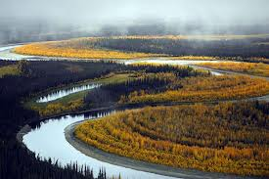
“[T]he public trust doctrine is rooted in the precept that some resources are so central to the well-being of the community that they must be protected by distinctive, judge-made principles.” Prof. Charles F. Wilkinson
Notes:
Put nature picture in back – river or ocean

Slide 34
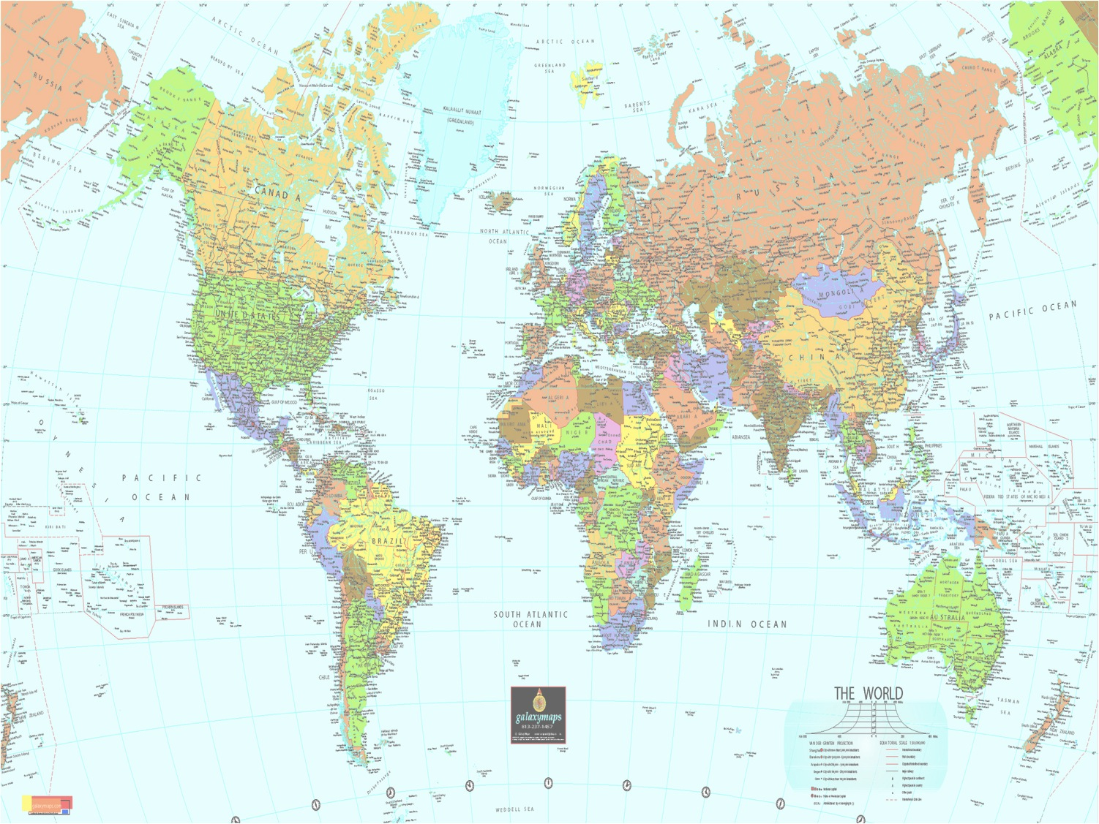
The Trust as an Attribute of Sovereignty
“[H]istory and precedent have established the public trust as an inherent attribute of sovereignty. . . .” Waihole Ditch 94 Haw. 97, 130-31 (Hawaii Supreme Court 2000).

Slide 35
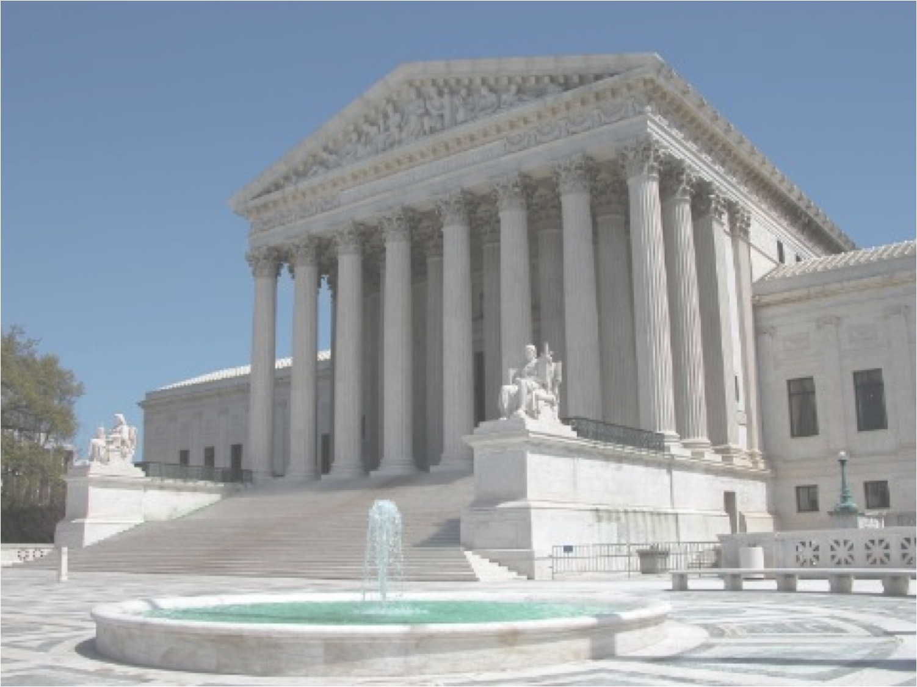
“The State can no more abdicate its trust over property in which the whole people are interested . . . than it can abdicate its police powers in the administration of government and the preservation of peace . . . .”
- Illinois Central R.R. v. Illinois, 146 U.S. 387, 453 (1982).
Notes:
Cannot abdicate it
35

Slide 36
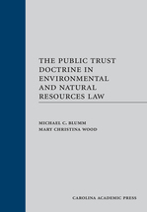
“The public trust doctrine carries enormous importance today, as many statutory systems fail in their basic purpose of protecting public resources. . . .”
p. xxxv
Notes:
Find page number

Slide 37
III. MODERN ENVIRONMENTAL LAW
Notes:
37

Slide 38
Has environmental law protected “Islands of Indianness”?

Slide 39
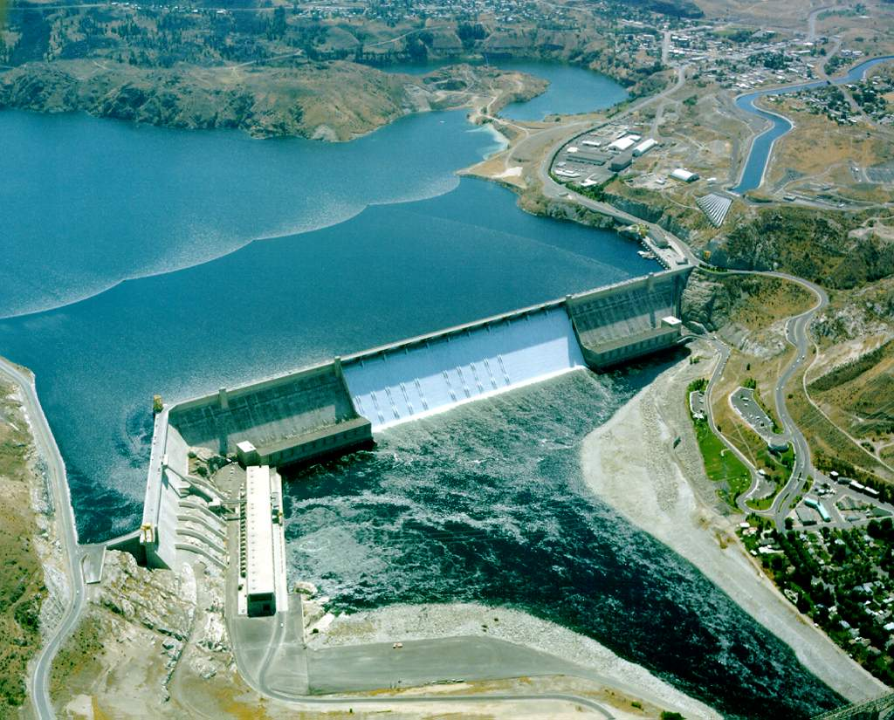
Devastated salmon runs, collapsed ecology

Slide 40
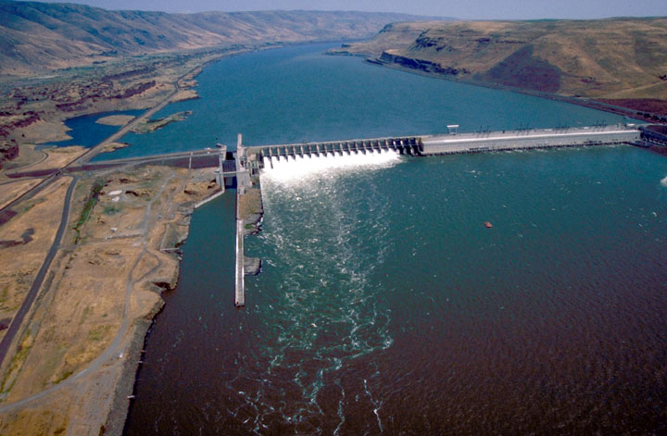
John Day Dam, Columbia River
My people are suffering. . . . It is almost impossible to describe in words the pain and suffering this has caused my people. We have been fisherman for thousands of years. It is our life, not just our economy.” Antone Minthorn, Umatilla Tribe

Slide 41
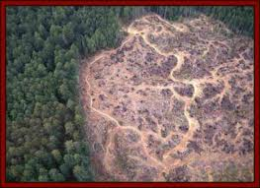
Industrial clear cuts

Slide 42
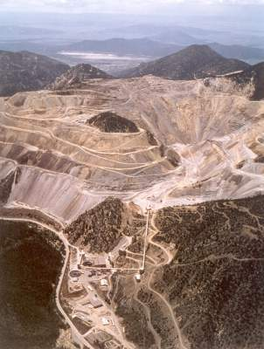
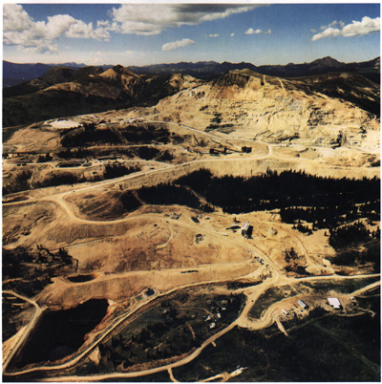
Industrial strip mining

Slide 43
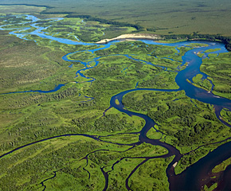
Pebble Mine proposed in Bristol Bay
2.5 billion tons of contaminated waste
Destroy 90 miles of streams bearing salmon used by Native Alaskans
Notes:
Canadian company owns gold and copper mining cliams – Pebble Mine in Bristol Bay would leave 2.5 billion tons of contaminated waste and destroy 90 miles of salmon bearing streams used by Native Alaskans [[[[Seth and Amanda – this needs header] put over the top.

Slide 44
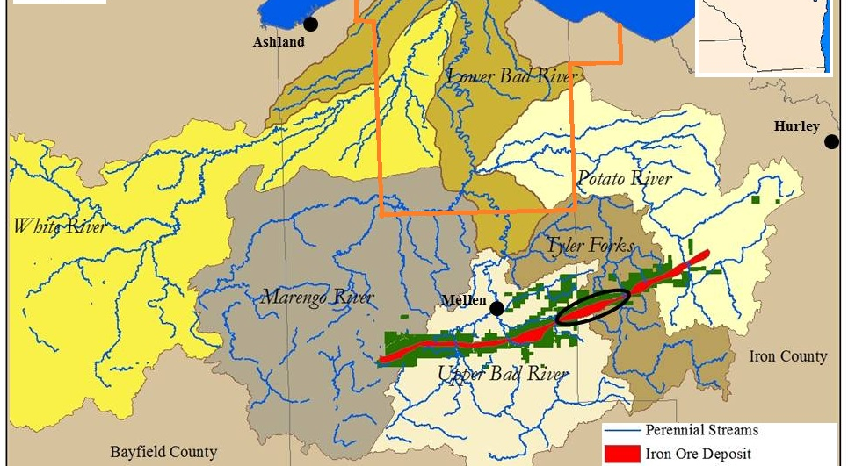
Iron Ore Mining in Objibwe Ceded Territory

Slide 45
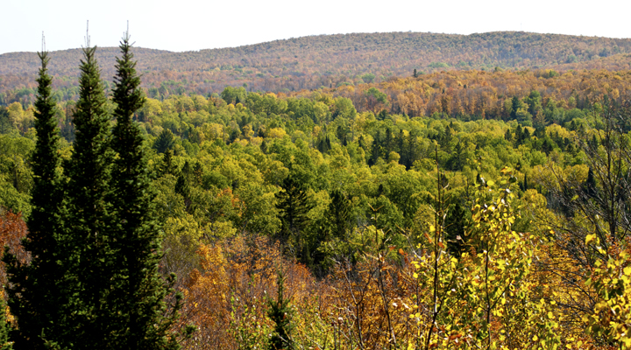
Penokee Ridge
Site of proposed mine
Notes:
Site of proposed mine

Slide 46
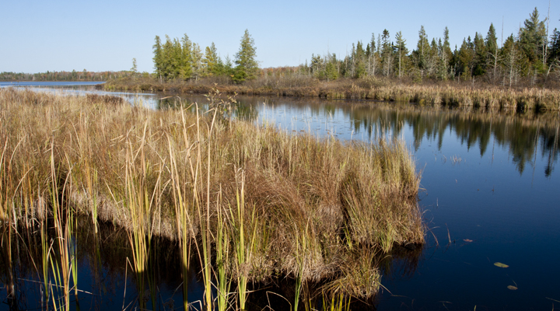
Kakogon Slough
Downriver from the proposed mine
Notes:
Area downriver of proposed mine

Slide 47
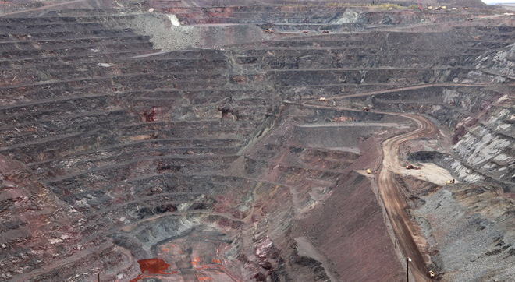
Michigan’s Empire Mine
One mile across; 1,200 feet deep
Notes:
An iron ore mine. One mile across; 1,200 feet deep

Slide 48
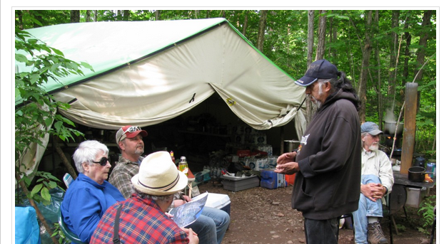
‘Harvest Camp’ Challenges Iron Ore Pit Mine

Slide 49
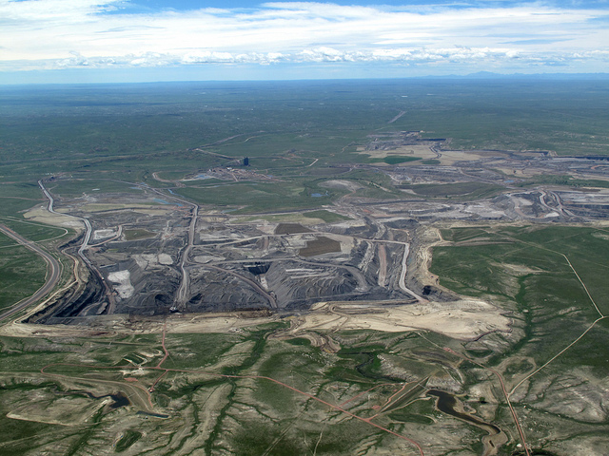
  “At stake is nothing less than the ecological integrity of the land base and the physical and social health of Native Americans throughout the continent.”
  Winona LaDuke

Slide 50
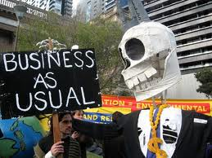
Predicted 9 -11°F warming over most of inland U.S. by 2090
Notes:
http://climateprogress.org/2009/06/15/us-global-change-research-program-noaa-global-climate-change-impacts-in-united-states/
Put in the report about tribes and climate change from the email Mary sent us on Oct. 2.

Slide 51
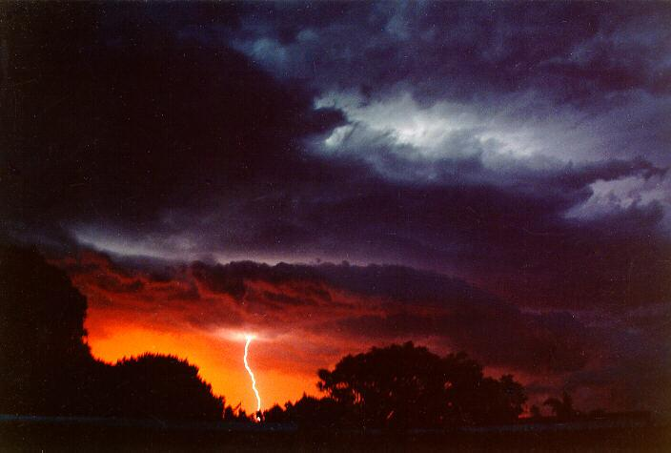
  Global warming threatens "not simply the Earth, but the fate of all its species, including humanity"
  Jim Hansen, Leading Climate Scientist, NASA
Notes:
51
A

Slide 52

Earth is in “imminent peril.” Continued carbon pollution will cause a “transformed planet.”
Hansen et. al.
Notes:
52

Slide 53
Ecological Collapse
  “If we continue to do exactly what we are doing, . . . the world in the latter part of this century will be unfit to live in.”
  James Gustave Speth, Dean, Yale School of Forestry, The Bridge at the Edge of the World (Yale Universtiy Press 2008)‏

Slide 54
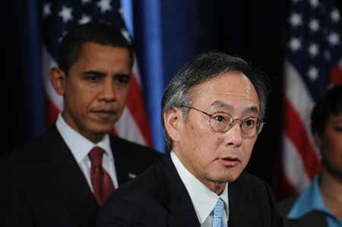
“I don't think the American public has gripped in its gut what could happen . . . We're looking at a scenario where there's no more agriculture in California… I don't actually see how they can keep their cities going either.”
– Steven Chu, Secretary of Energy under President Obama
Notes:
54

Slide 55
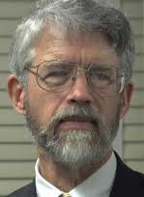

“The current situation of the world in relation to the climate problem is that we’re in a car with bad brakes driving toward a cliff in the fog . . . . “
John Holdren, President Obama’s science advisor

Slide 56
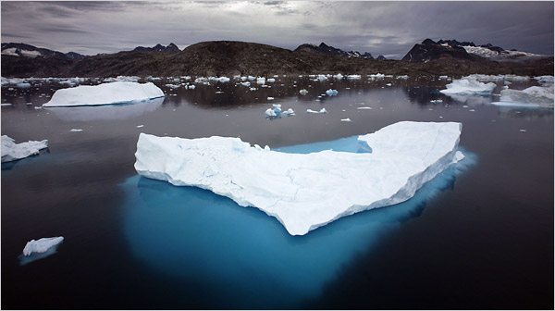
“What we do in the next two to three years will determine our future. This is the defining moment.”
Rajendra Pachauri, head of the UN IPCC, 2007
Notes:
Elizabeth Rosenthal, U.N. Chief Seeks More Climate Change Leadership, N.Y. TIMES, Nov. 18, 2007, available at http://www.nytimes.com/2007/11/18/science/earth/18climatenew.html?scp=1&sq=UN%
20Panel:%20avert%20climate%20disaster&st=cse.

Slide 57
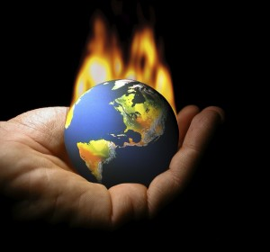
“We are at a planetary
tipping point.””
And still no comprehensive regulation of carbon dioxide from EPA

Slide 58
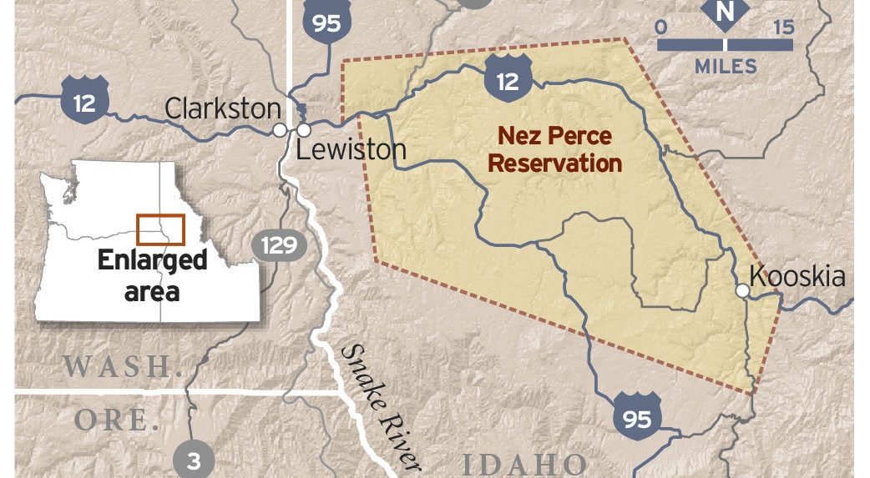
Mega-load Route Through Reservation

Slide 59
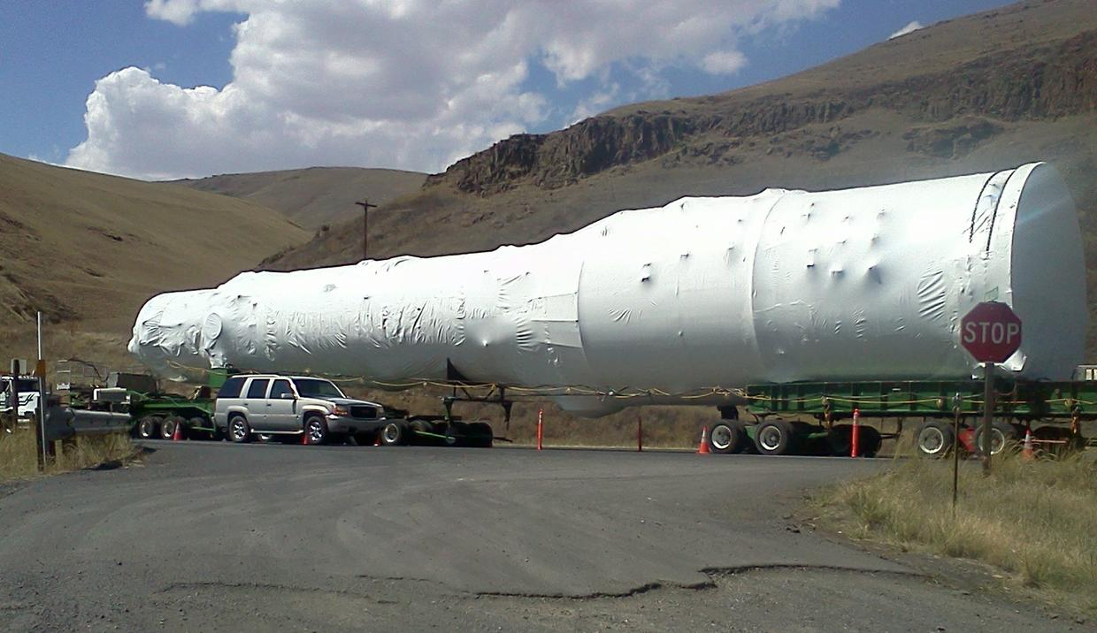
One of the Mega-loads
644,000 Pounds
225 Feet Long, 21 feet wide, & 23 feet tall
Notes:
An evaporator to be used in the oil refining process on Canada’s tar sands sits in the median of U.S. Highways 95 and 12 on Tuesday, August 6, 2013.

Slide 60
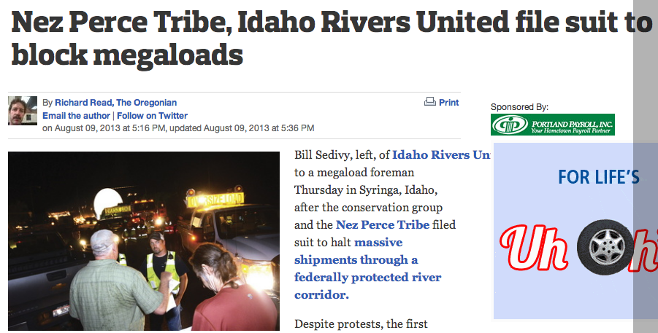
August 8, 2013
Notes:
Day three of blockade

Slide 61
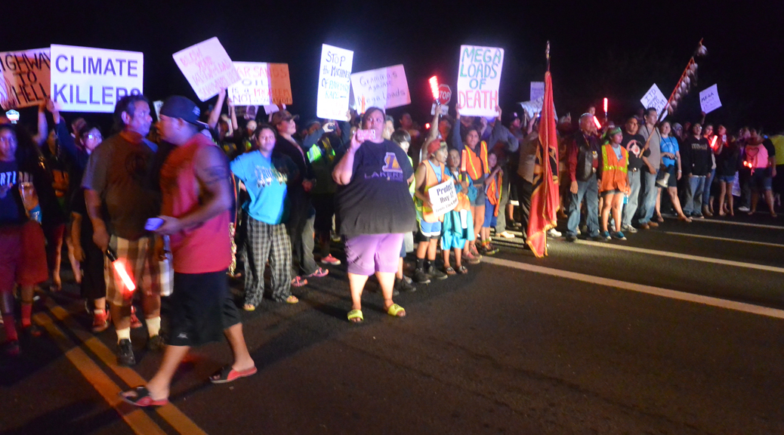
The Nez Perce Blockade
August 6th – 9th, 2013
Notes:
It might be worth noting the the tribal resistance to tar sands in the US is part of a broader movement involving Canadian First Nations.

Slide 62
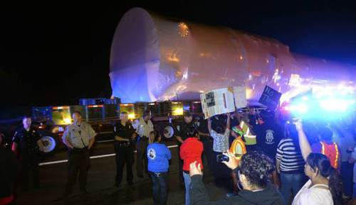
Notes:
By Friday August 9, at least 30 people had been arrested.

Slide 63
Silas Whitman Quotes
“We tie this together with the [Keystone] XL pipeline. We want to help our brothers and sisters in the First Nations of Canada, and the Sioux Nation and the Oklahoma and Nebraska tribes.”
– Silas Whitman, Nez Perce Executive Committee Chairman
“We couldn’t turn the cheek anymore”
– Silas Whitman, Nez Perce Executive Committee Chairman
Notes:
From: NY Times Article, “Fight Over Energy Finds a New Front in a Corner of Idaho” find a picture of silas

Slide 64

District Court Grants Injunction September 13, 2013
"Overarching this statutory duty, is the Government’s duty as trustee over the Tribe. The Supreme Court has held that the constitutionally recognized status of Indians justifies special treatment on their behalf when rationally related to the Government’s unique obligation toward the Indians.”
-Washington v. Washington Commercial Passenger Fishing Vessel Assoc., 443 U.S. 658, 673 n. 20 (1979)"

Slide 65
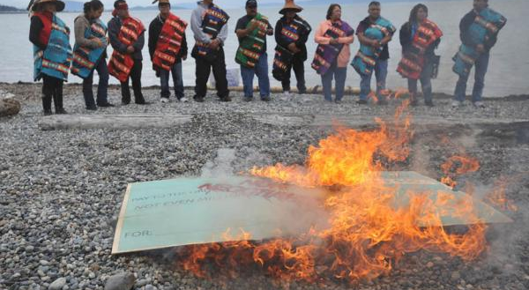
Coal and the Tribal Trust
Notes:
Members of the Lummi Nation protest the proposed coal export terminal (Gateway Pacific Terminal) at Cherry Point in 2012. Gateway is one of six proposed coal terminals in the Pacific Northwest.

Slide 66
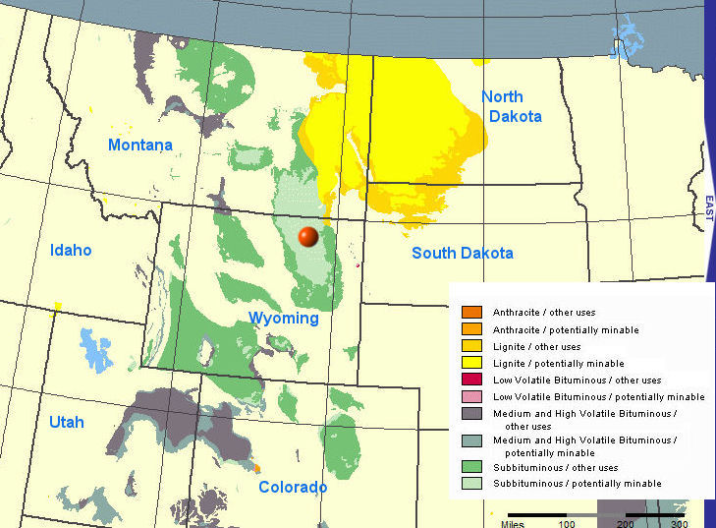
Western Coal Reserves

Slide 67
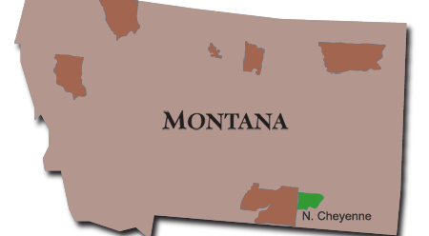
The Northern Cheyenne Reservation
Notes:
As you can see, the reservation is much smaller than the actual area of Montana and Wyoming. The strip mining activity has abutted the reservation itself.

Slide 68
Coal and the Northern Cheyenne
The Northern Cheyenne Reservation has one of the largest coal reserves of any tribe in Indian Country.
  Northern Cheyenne refuses coal development on its lands
  Federal coal leasing adjacent to Cheyenne land.
Notes:
From www.montanatribes.org

Slide 69
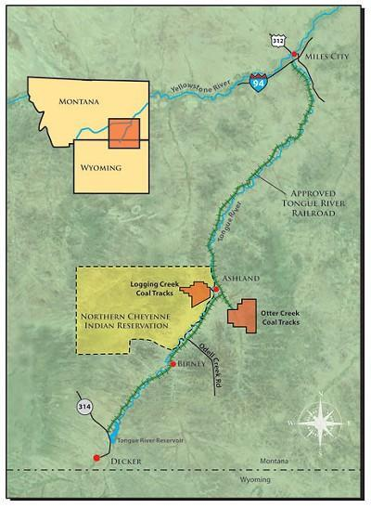
Notes:
Proposed Otter Creek Mine in relation to the reservation and the new railroad that would support it.

Slide 70

Otter Creek

Slide 71

Powder River Coal Mine

Slide 72

Current Powder River Coal routes
Notes:
As you can see, the vast majority of Powder River Coal is now consumed in the United States, primarily in the Midwest and East.

Slide 73

Proposed coal trains for Columbia Gorge

Slide 74

Proposed Coal Exports
Notes:
These exports would indefinitely expand the lifetime of the Powder River Basin Coal mines and would create new rail traffic throughout the Northwest and in the territories of many tribes on their way to Asia.

Slide 75

Cherry Point, Washington
Cherry Point is the proposed site for the largest coal port in North America, the Gateway Pacific Terminal. It is also a 3,500-year-old village site of the Lummi Nation. The coal port dock is proposed to go over top of a documented reef net site of the Lummi people.
“Fishing is our culture. To us, culture is fish. So it could be, and will be, very detrimental if coal goes through.” - Jay Julius, Councilmember Lummi Nation
“You’re talking 465 supersized tankers that aren’t even allowed to come through here now. When you have that kind of traffic out here, going up to Alaska from here, to China, this would be completely be eliminated. No more fishing. The impacts we are going to feel here for our children’s children, for twenty five years of jobs. It’s all about money.”- Jay Julius, Councilmember Lummi Nation
“I believe this is one nation under God, but I think if things like this continue to go through, it’s not. It’s one nation under money.” - Jay Julius, Councilmember Lummi Nation

Slide 76
Lummi Nation Letter to
Army Corps of Engineers
July 30, 2013
"The Lummi Nation expects that the Corps of Engineers (Corps), on behalf of the United States of America, to honor the trust obligations to the Lummi Nation related to these proposed projects. We believe that the Corps should see that these projects would without question result in significant and unavoidable impacts and damage to our treaty rights.... to fish, gather and hunt in the usual and accustomed places."
-Tim Ballew II, Chair Lummi Indian Business Council

Slide 77


Lummi Nation Totem Pole Journey
September 18th - 29th
Members of the Lummi Nation embarked on a 1,500-mile journey to connect the tribal nations along the coal corridor -- from Wyoming’s Powder River Basin to Xwe’chi’eXen, British Columbia.
Notes:
The House of Tears carvers of the Lummi Nation has created a tradition of carving and delivering totem poles to areas struck by disaster or in need of hope and healing. This totem pole journey is intended to bring hope and healing to the Lummi Nation’s own sacred land, land threatened by a proposal to build North America’s largest coal port: the Gateway Pacific Terminal. The totem pole will be placed in the homeland of the Tsleil-Waututh Nation, demonstrating unity with the Canadian First Nations’ position opposing the transport of Tar Sands by pipelines across their territories.

Slide 78

ENVIRONMENTAL LAW
Notes:
78

Slide 79
ENVIRONMENTAL LAW
Statutes Passed by Congress
Notes:
79

Slide 80
ENVIRONMENTAL LAW
Statutes Passed by Congress
Benefit Majority Society
Notes:
80

Slide 81
ENVIRONMENTAL LAW
Statutes Passed by Congress
Benefit Majority Society, not tribes
Agency failure
Notes:
81

Slide 82


The agencies – in the business of permitting pollution.
Notes:
GERRARD ET AL., GLOBAL CLIMATE CHANGE AND U.S. LAW 259 (ABA 2007).
82

Slide 83

Problems with environmental law

Slide 84
Problems with environmental law
Agencies have enormous discretion

Slide 85
Problems with environmental law
Agencies have enormous discretion
They are politicized/captured

Slide 86
Problems with environmental law
Agencies have enormous discretion
They are politicized and captured
They don’t say no to permits sought by industry

Slide 87
Problems with environmental law
Agencies have enormous discretion
They are politicized/captured
They don’t say no to permits sought by industry
Science used as a façade for politics

Slide 88
Problems with environmental law
Agencies have enormous discretion
They are politicized/captured
They don’t say no to permits sought by industry
Science used as a façade for politics
Judges give discretion to agencies

Slide 89

The Earth Endowment – Being Spent By Agencies Carrying out Environmental Statutes
Overall, the Earth’s natural ecosystems have declined by 33% during the last thirty years
Notes:
according to a comprehensive report issued in 2000 by the World Wildlife Fund (WWF).
WWF, LIVING PLANET REPORT 2000 at 1 (Jonathan Loh ed., 2000), available at http://assets.panda.org/downloads/lpr2000.pdf.

Slide 90

Notes:
Can you put background? Or make it fill up page? Don’t think that’s possible.

Slide 91
Environmental Law Assimilates Legal Rights of Tribes

Slide 92
Environmental Law: Assimilating legal rights of tribes
Environmental statutes were passed to protect majority needs.

Slide 93
Environmental Law: Assimilating legal rights of tribes
Environmental statutes were passed to protect majority needs.
They fail to protect unique tribal substantive interests.

Slide 94
Environmental Law: Assimilating legal rights of tribes
Environmental statutes were passed to protect majority needs.
They fail to protect unique tribal substantive interests.
Government agencies assimilate the unique legal claims of tribes into ineffective statutory processes

Slide 95
Environmental Law: Assimilating legal rights of tribes
-- passed to protect majority needs.
-- fail to protect unique tribal interests.
-- government agencies assimilate the unique legal claims of tribes into ineffective statutory processes
-- consultation rarely yields protection; instead, tribes inundated with process

Slide 96

Examples:
Clean Water Act – Fish Consumption standards
Endangered Species Act – harvestable populations versus survival populations
Notes:
Fish background.
Maybe tribal fishers.

Slide 97
III. THE INDIAN TRUST DOCTRINE AND MODERN ENVIRONMENTAL LAW
Notes:
97

Slide 98

“Enforcement of the federal trust responsibility is necessary to protect Native America from environmental assault.” (Wood, 2003)
The trust responsibility provides a standard of protection that guides agency discretion within the confines of statutory law.

Slide 99

Columbia Tribes Fish Recovery
Ex: Professor Catherine O’Neill argued that the trust responsibility required EPA to change standards of fish consumption in setting water quality standards under the Clean Water Act
Notes:
Move this, make it look nice.

Slide 100


CRITFC study --tribal members consumed up to 389 grams of fish per day
EPA -- average consumption of citizens is 17.5 grams per day (that’s the amount that fits on a cracker!)
Notes:
Need some sort of color background for the writing

Slide 101
Early case law finding trust obligation within framework of statutory law
Administrative Procedure Act -- arbitrary, capricious, or “otherwise not in accordance with law.”
-- courts enjoined harmful agency action (or upheld protective agency action) off the reservation
-- interpreted trust duty as separate from statutes but within statutory confines to guide discretion
Notes:
Can we make these roll in from the right?
Make the header into a header.

Slide 102

Pyramid Lake Paiute Tribe v. Morton – Secretary of Interior must send all water in Truckee River that was not obligated by contract or decree to Pyramid Lake to support tribal fishery.
Northern Cheyenne Tribe v. Hodel – rejected BLM proposal to lease federal lands for coal mining outside Northern Cheyenne Reservation: “[A] federal agency’s trust obligation to a tribe extends to actions it takes off a reservation which uniquely impact tribal members or property on a reservation.”

Slide 103

Northwest Sea Farms v. U.S. Army Corps of Engineers (date) – upheld Corp’s refusal to issue permit for fish farm that could interfere with treaty rights. “It is this fiduciary duty, rather than any express regulatory provision, which mandates that the Corps take treaty rights into consideration.”
Klamath Tribe v. U.S. Forest Service (1996) – halted timber sale on federal forest lands, finding government had a “substantive duty to protect ‘to the fullest extent possible’ the Tribes’ treaty rights, and the resources on which those rights depend.’”
Notes:
Include dates.
Try to roll in the text piece by piece.

Slide 104

Parravano v. Babbitt (1996) – upheld Commerce regulation to halt non-Indian fishing as application of trust duty to protect salmon runs relied on by Hoopa Valley and Yurok Tribes “[the Department’s] original trust responsibility [requires it] to consult with the Tribes and to identify, protect, and conserve trust resources, trust assets, and Tribal health and safety in making its . . . decisions.”
Notes:
Add date.

Slide 105

Nez Perce Tribe et. al v. USFS Case No. 3:13-CV-348-BLW (US Dist. Court Idaho, Sept. 13, 2013)
"Overarching this statutory duty, is the Government’s duty as trustee over the Tribe. The Supreme Court has held that the “constitutionally recognized status of Indians justifies special treatment on their behalf when rationally related to the Government’s unique obligation toward the Indians.” Washington v. Washington Commercial Passenger Fishing Vessel Assoc., 443 U.S. 658, 673 n. 20 (1979)."

Slide 106

This trust responsibility extends not just to the Interior Department, but attaches to the federal government as a whole.” Parravano v. Babbitt
“The government’s trust obligations can . . . coexist with its other responsibilities.” Hoopa Valley v. Ryan
Department of Commerce, Magnuson Fisheries Act
U.S. Army Corps of Engineers, Rivers and Harbors Act
Forest Service, National Forest Management Act
Forest Service, Wild and Scenic Rivers Act
BLM, Federal Land Policy Management Act
Interior, Water Decrees and Compacts
Bureau of Reclamation
Notes:
Roll in the agencies, maybe add logo?

Slide 107

But some case law has taken a U-turn from protective fiduciary obligations
-- Suits for damages under Tucker Act
-- These are claims for breach of fiduciary duty in managing tribal property
-- Tucker Act requires that claim arise under Constitution, laws, or treaties of the U.S. or executive orders
-- These cases require specific expression of trust duty

Slide 108
Tucker Act Cases in the US Supreme Court
-- Mitchell I (1980)
-- Mitchell II (1983)
-- White Mountain Apache (date)
-- Navajo Nation (date)
-- Jicarilla Apache (2011)
Notes:
Tucker act supreme court cases, plus a background.

Slide 109

Competing conceptions of trust in Jicarilla
Justice Alito:
“[The] trust is defined and governed by statutes rather than the common law.”
Justice Sotomayor:
“We have never held that all of the Government’s trust responsibilities to Indians must be set forth expressly in a specific statute or regulation.”
Notes:
Pictures of these two.

Slide 110


Cases now require specific statutory expression of trust to enjoin damaging agency action under the Administrative Procedure Act

Slide 111

North Slope Borough v. Andrus (1980) – suit by Inupiat under APA to half federal oil leasing in Beaufort Sea which threatened bowhead whale population
“A trust responsibility can only arise from a statute, treaty, or executive order; in this respect we are governed by the recent Supreme Court decision in United States v. Mitchell holding that the United States bore no fiduciary responsibility to Native Americans under a statute which contained no specific provision in the terms of the statute.”

Slide 112

Other cases in 9th Circuit:
Gros Ventre (2006) – “We recognize that there is a “distinctive obligation of trust incumbent upon the Government in its dealings with [tribes]. That alone, however, does not impose a duty on the government to take action beyond complying with generally applicable statutes and regulations.”
Morongo Band of Mission Indians (1998) – “[Unless there is a specific duty that has been placed on the government with respect to Indians, this responsibility is discharged by the agency’s compliance with general regulations and statutes not specifically aimed at protecting tribes.”
Notes:
Insert date and put in color to match other slide with cases – proof read!

Slide 113

Department of Justice advances the assimilationist position:
Recent brief in Navajo Nation v. U.S. Dept. of Interior: cites Gros Ventre v. U.S., “the government’s general trust obligation is discharged by the government’s compliance with general regulations and statutes not specifically aimed at protecting tribes.”

Slide 114

Albert Einstein
The definition of insanity: doing the same thing over and over again and expecting different results.

Slide 115

Jaime Lynn Butler, Navajo
TRUST Arizona

Slide 116

Nelson Kanuk
17 years old
TRUST Alaska
Yup’ik Eskimo Tribe

Slide 117

Xiuhtezcatl Martinez
Aztec
TRUST Colorado

Slide 118

The Federal ATL Case

Slide 119

History suggests that if mankind is to survive, the next five hundred years must be rooted in the pre-Columbian ethic of the Native American. The continuation of the past, the conqueror’s exploitation of the earth, can mean only one thing. No one, Indian or non-Indian, will survive.
— Rennard Strickland, Professor Emeritus, University of Oregon School of Law

