Slide 1
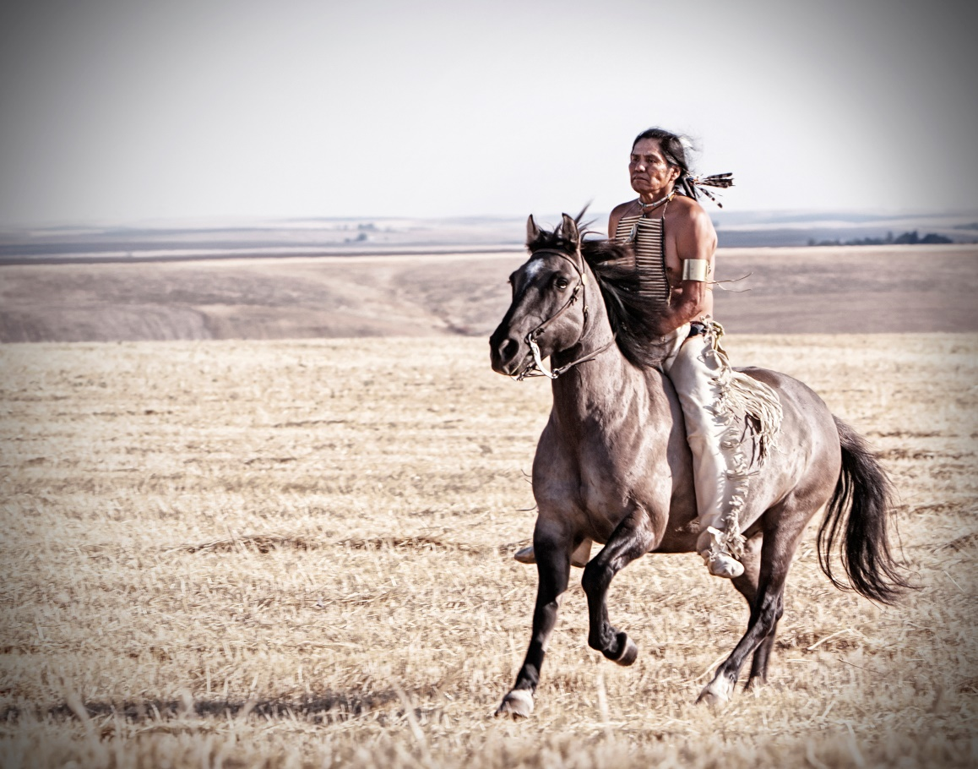
Pathways, Challenges, and Promise in
Native American Indian Law:
Taking a Long View in our Symbiotic Relationship with Nature
Tamanwit – Tiica’m – Nati’tayt
Natural Law – Land - People
Charles F. Sams III, MLS

Slide 2
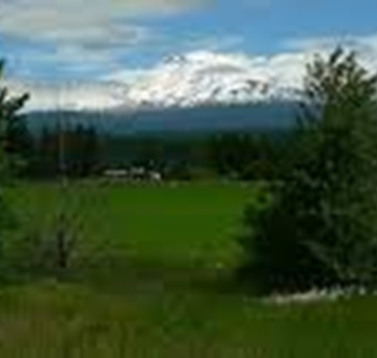
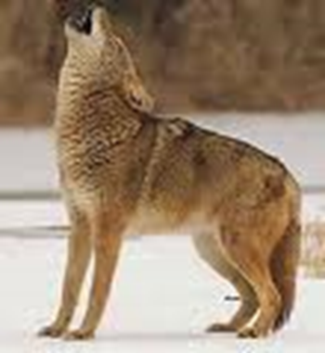



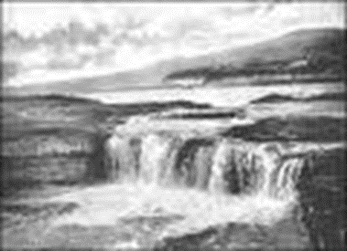
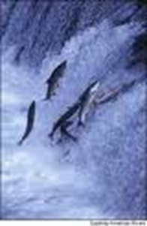
Tamanwit - Natural Law
Being Stood Up – Being Human
Land Ethic - Geopiety
Coyote and Human – Trickster Tale
Myth & Legends v. Reality
Gifts of the Land + Stewardship Responsibility
Covenants/Promises

Slide 3
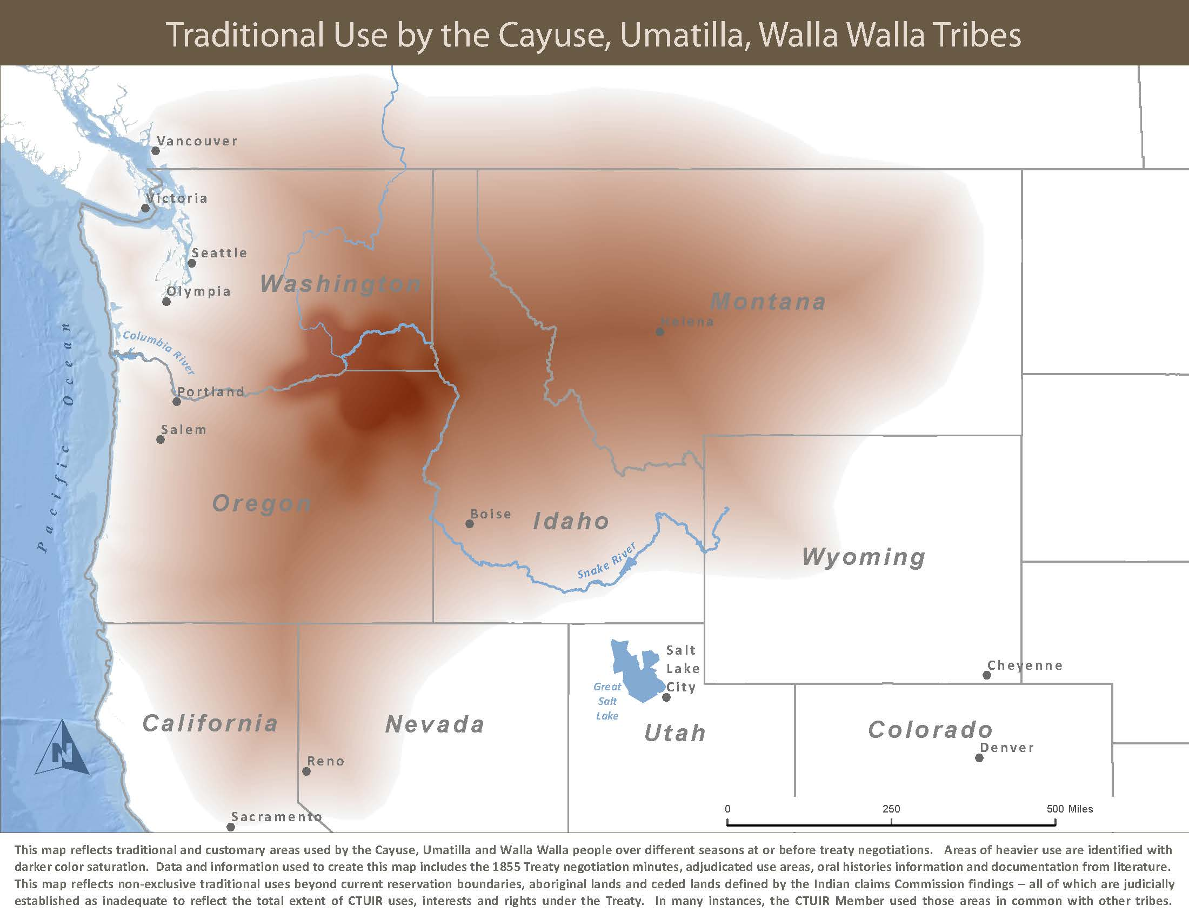
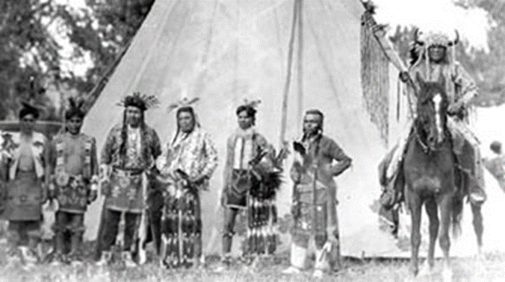
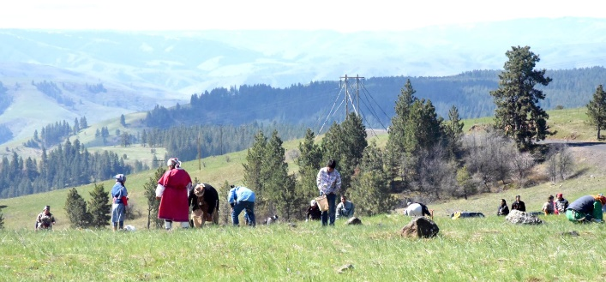
Tiica’m - The Homelands
Land and Religion
Land Donation Acts
General Allotment Act
Indian Reorganization Act

Slide 4
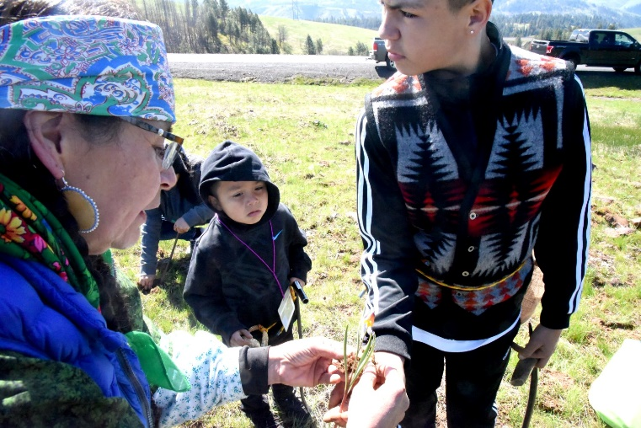
SEASONAL HOMES. Seasonal migration patterns flowed in a directional movement along a seasonal round, from the main stems to the tributaries.
Nati’tayt - People
Hunter/Gather + Agriculture= Horticultural Society
Human Rituals for Renewing and Returning of First Foods and Resources
Seasonal vs. Nomadic – Vision Quest, Art, Sweat, Story Origins

Slide 5
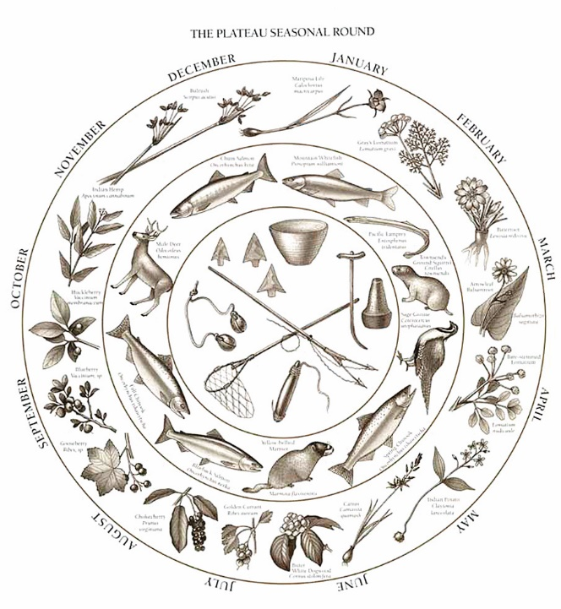
Today
Practice our Traditional Rounds
Live with the Land
Steward the Resources

Slide 6
Federal Indian Policy
1633 General Court of Mass. Indian Land Allotment
1754 Albany Congress – Unified Colonial Indian Policy
1763 King George III Proclamation of Indian Land
1778 1st Indian Treaty with U.S. Continental Congress
1789 War Department oversees Indian Affairs
1790 Trade and Intercourse Act
1803 Louisiana Purchase
1820 Federal Gov’t Authorized to hold Trust funds
1824 War Secretary creates BIA
1830 Indian Removal Acts – multiple
1834 Congress establishes IIM Trusteeship
1843 Intercourse Act – restricts Tribal rights
1858 Land Donation Acts – multiple
1868 Indian Peace Commission negotiates final treaty with Tribes
1871 Congress passes act to abolish treaty making with Tribes
1885 Major Crimes Act
1887 Dawes Act
1920 Competency Commission established
1921 Snyder Act
1924 Indian Citizen Act
1924 Indian Health Division established
1934 Howard – Wheeler Act – Indian Reorganization
1934 Johnson O’Malley Act
1936 Oklahoma Indian Welfare Act
1936 Alaska Native Welfare Act
1946 Indian Claims Commission established
1947 BIA formally established
1952 PL 83-280
1953 Termination Act – HCR 108
1954 IHS transferred to BIA
1964 Economic Opportunity Act
1968 Indian Civil Rights Act
1971 Alaska Native Claims Settlement Act
1973 Congress repeals Termination Act
1975 PL 93-638 Indian Self Determination /
Education Assistance Act
1978 Indian Child Welfare Act
1988 Indian Gaming Act
1994 Indian Trust Reform Act

Slide 7
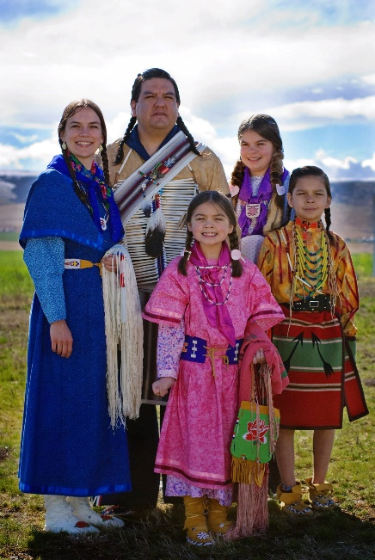
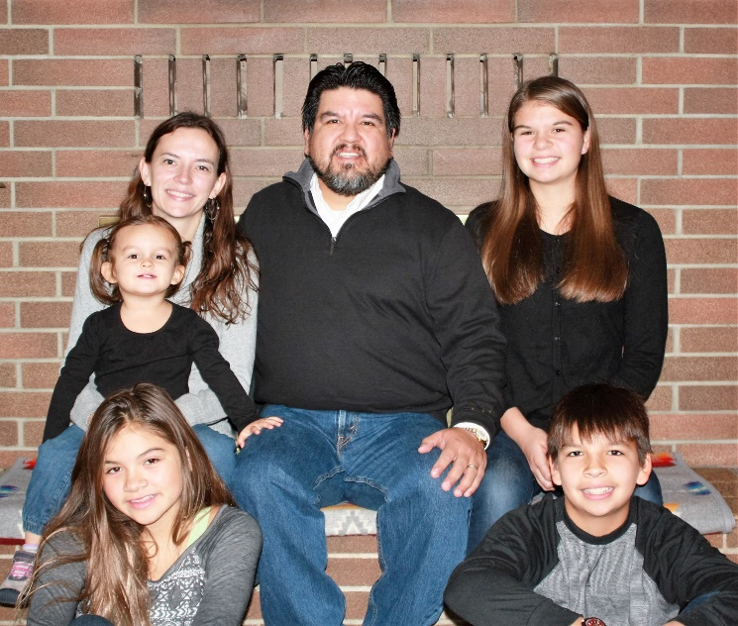
Reclaiming Who We Are
We are a diverse People – we are not homogenous
Savage Warrior v. Noble Savage – We are Human
Racist Mascots are OUT
50% of Americans say what they were taught in school was inaccurate
72% say curriculums need updated and presented about American Indians
Committed to Preserving Our Culture, Religion, Customs, Lifeways
Committed to Family & Community
Celebration of Resiliency in the Face of near extinction

Slide 8

References & Resources
U.S. Constitution
Indian Removal Act (1830)
General Allotment Act (1887)
Indian Reorganization Act (1934)
National Historic Preservation Act (1966)
National Environmental Policy Act (1969)
American Indian Religious Freedom Act (1978)
Native American Graves Protection and Repatriation Act (1990)
Religious Freedom Restoration Act (1993)
Religious Land Use and Institutionalize Persons Act (2000)
Walker, Deward, Jr., “Protection of American Indian Sacred Geography,” in the Handbook of American Indian Religious Freedom pages 101-115, Christopher Vecsey, ed. (1991).
Tsosie, Rebecca. Tribal Environmental Policy in an Era of Self-Determination: The Role of Ethics, Economics and Traditional Ecological Knowledge, 21 Vermont Law Review 225, pages 268-287, (1996)
Barsh, Russel L. Visions: Native American Conceptions of Landscapes and Ceremony. St. Thomas Law Review. Vol. 13, pp. 127-154 (2000)
Oregon Historical Quarterly 2007 issue 108:4 Special Issue – Remebering Celilo - Wakanish Naknoowee Thluma: ‘Keepers of the Salmon’ by Charles F. Sams III
Karson, Jennifer. (2006) As Days Go By: Our History, Our Land, and Our People The Cayuse, Umatilla, and Walla Walla. Pendleton, Oregon: Tamastslikt Cultural Institute.

