Slide 1
Joining the National Legal Writing Community through Service
Suzanne Rowe
University of Oregon School of Law

Slide 2
Legal Writing Organizations and Publications
Ways to Get Involved
Reasons to Get Involved

Slide 3
Legal Writing Organizations and Publications
MAJOR ORGANIZATIONS
Legal Writing Institute
Association of Legal Writing Directors
AALS Section of Legal Writing, Reasoning, and Research
Others: SEALS, Scribes, WAR, etc.
Publications
Peer edited journals
Legal Writing (LWI)
LC&R (ALWD)
Others
The Second Draft (LWI)
Perspectives (West/Thomson Reuters)
AALS Newsletter
Proceedings

Slide 4
Write!
Edit!

Slide 5
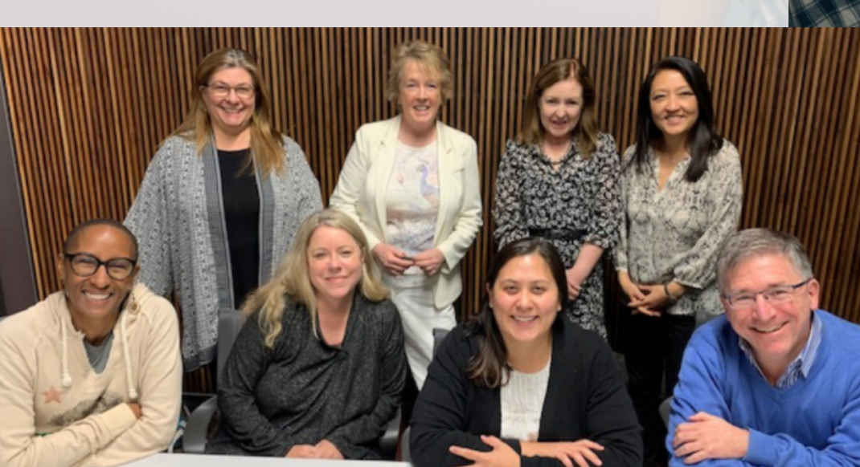
Getting Involved
Join a committee
Embrace your passion
diversity, connections to the bar, scholarship, teaching, online learning
Not
program planning for a major conferences
survey or ALWD Guide
awards or nominations
Notes:
Photo from LWI website.

Slide 6
Developing a Reputation
Show up
Listen
Contribute
Respond to emails
Offer to help
Don’t overcommit
Assume people want to get to know you

Slide 7
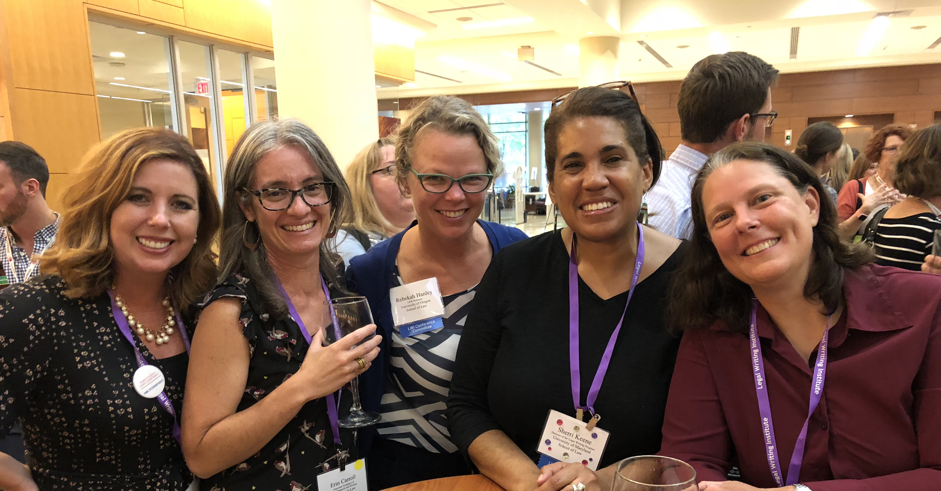
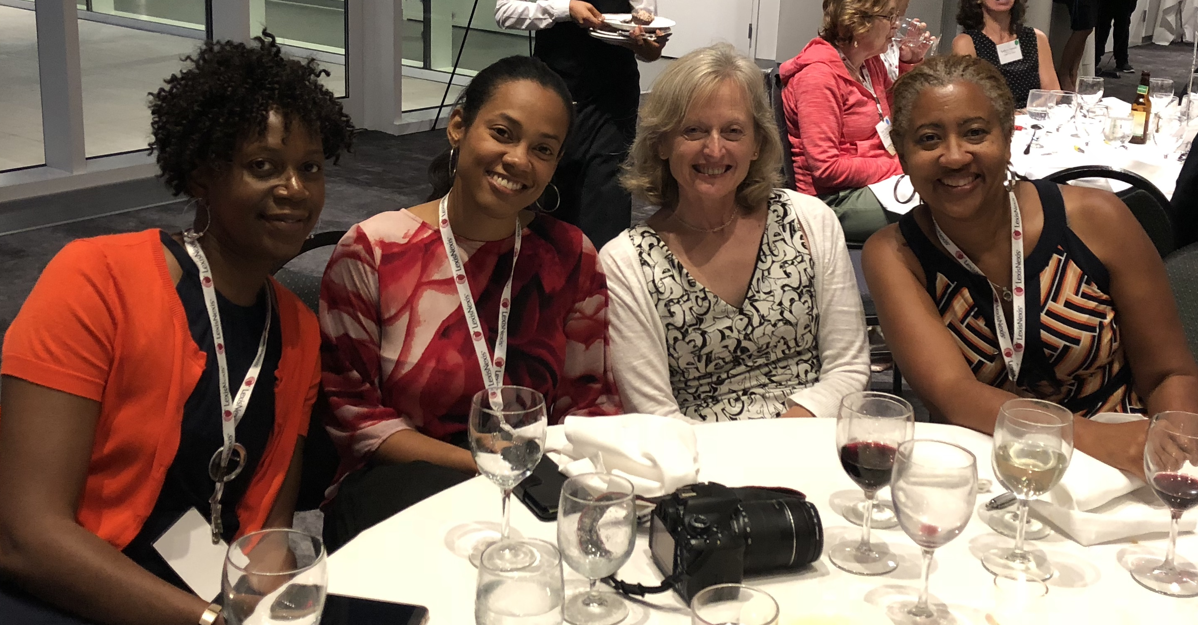
Attend a conference
LWI (even years)
ALWD (odd years)
AALS and SEALS (annually)
Applied Storytelling (odd years)
Regional conferences
Rocky Mountain (annually)
Western States (annually)
Central States (odd years)
Empire State (odd years)
Notes:
Photos from LWI 2018

Slide 8
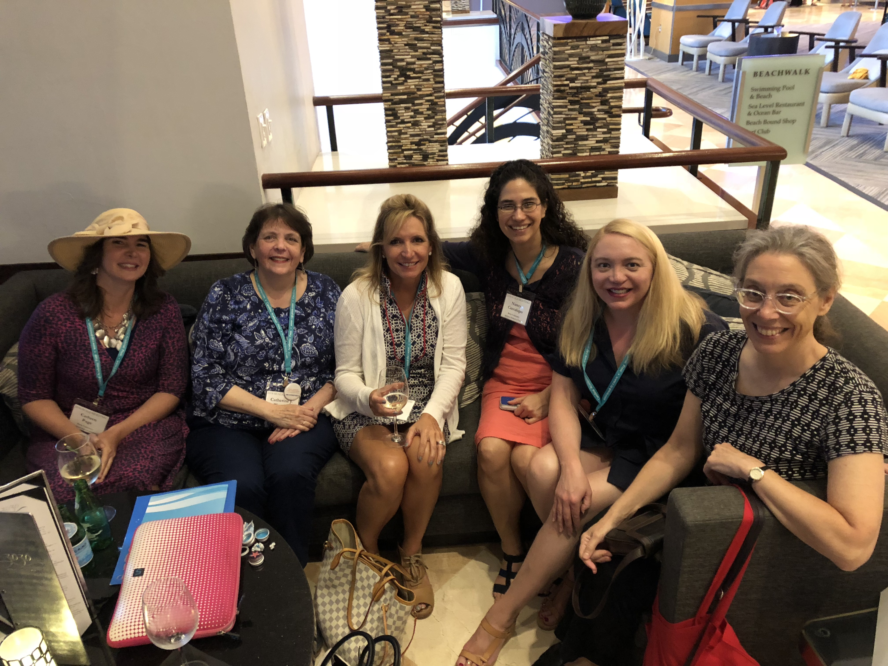
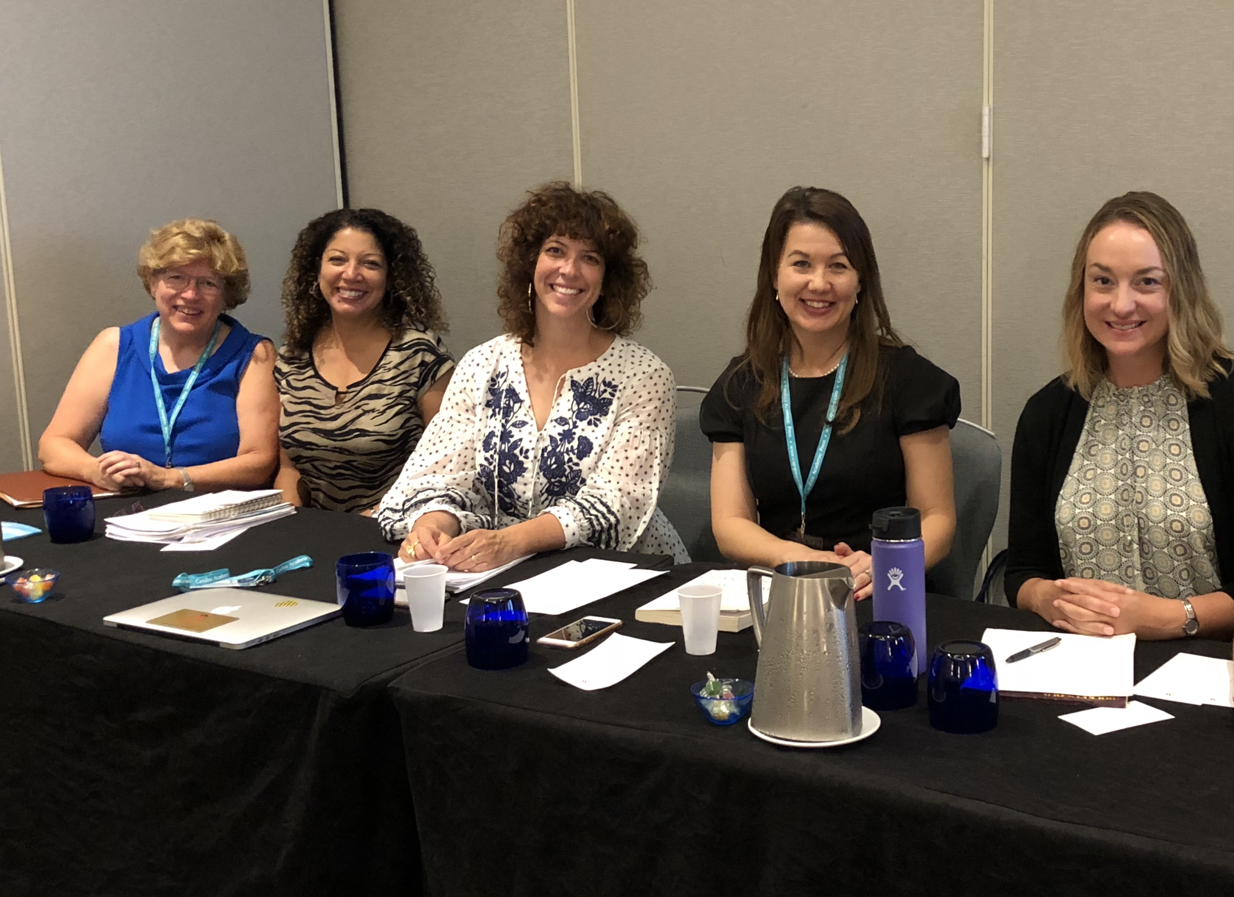
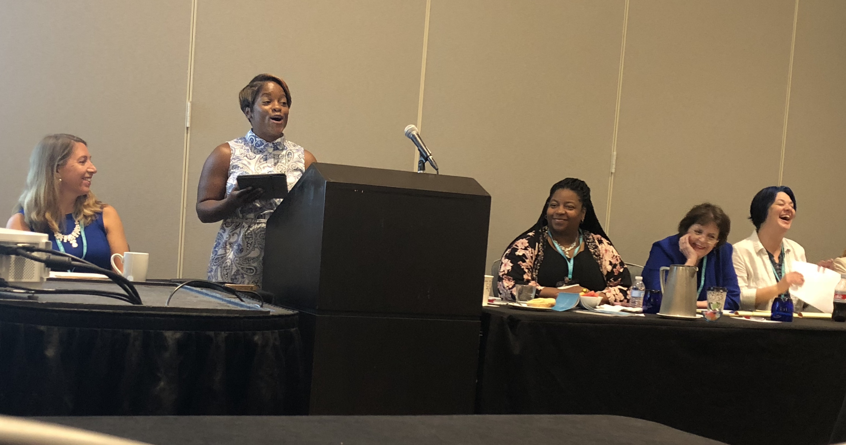
At conferences
Find a friend
Don’t be shy
Talk to speakers afterwards
Send thanks afterwards
PRESENT!
Share your new ideas
Join a group presentation
SOCIALIZE!
Notes:
Photos from SEALS 2019.

Slide 9
How much does service matter? (It depends on the school.)

Slide 10
WHY?
Learn about legal writing
Find a mentor
Find a cohort
Get ideas for scholarship
Develop a reputation
Other service: supporting students, serving on faculty committees, taking on school initiatives

Slide 11
How to say, “No.”
Thanks for thinking of me.
I’m not able to take on additional obligations now.
I hope you’ll think of me in the future.
Is there a small way to help now?

Slide 12
Welcome to Legal Writing!

